Slide 1

PARKING SPACE DETECT
TASK 1: Detection of Parking Space in 2D Image
_Amanullah Tariq, Muazzam Ali and Deep Ganatra

Slide 2
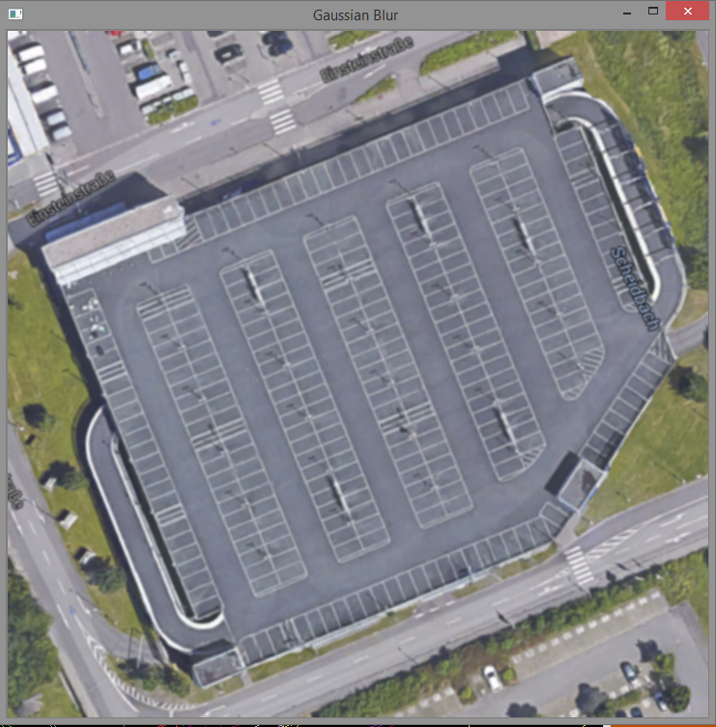
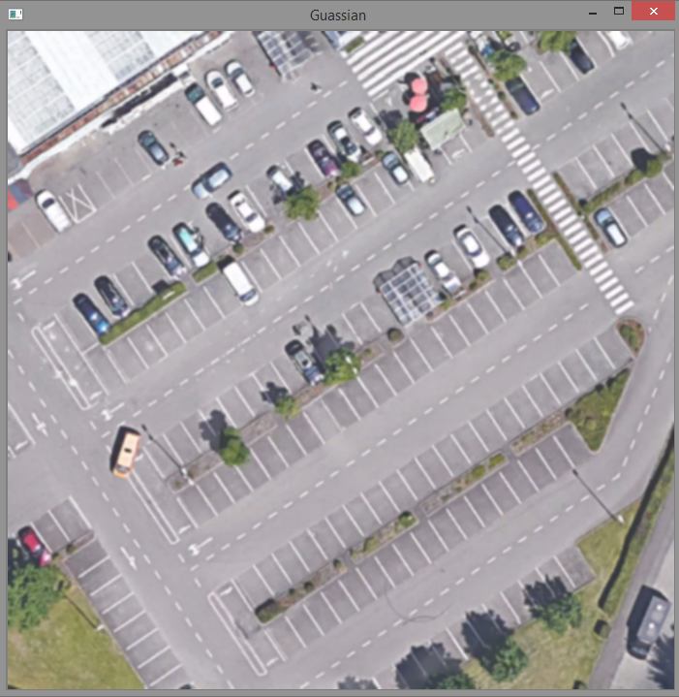
Image Processing
Filtering techniques:- To reduce the noises while detecting lines of Parking Space.
Gaussian Blurring :– Thickens and dulls the Edges of Image and doesn’t remove noise well.

Slide 3
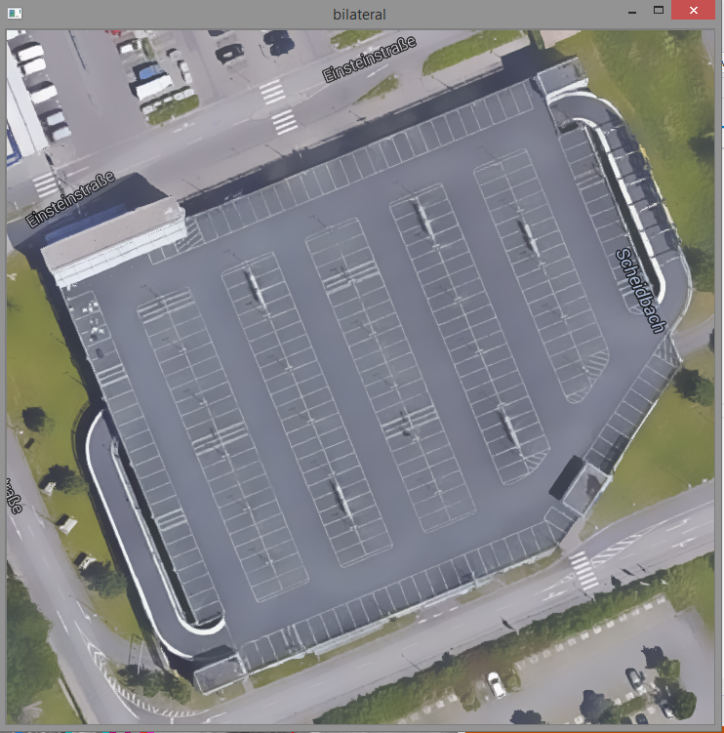
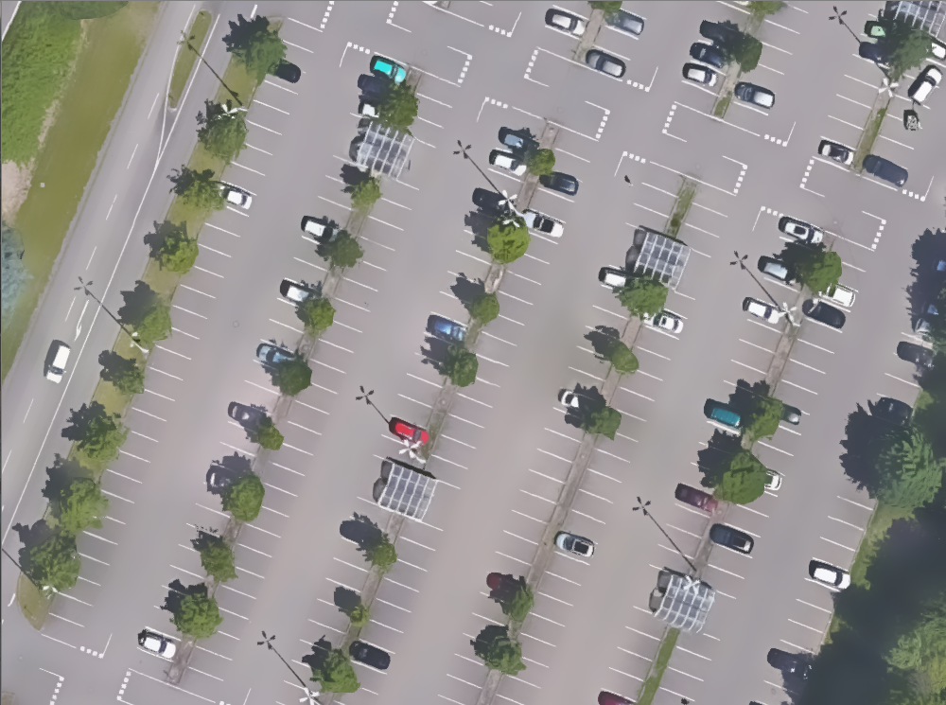
Bilateral Filtering :– Detects the Edges quite well and reduces the unwanted noises.

Slide 4
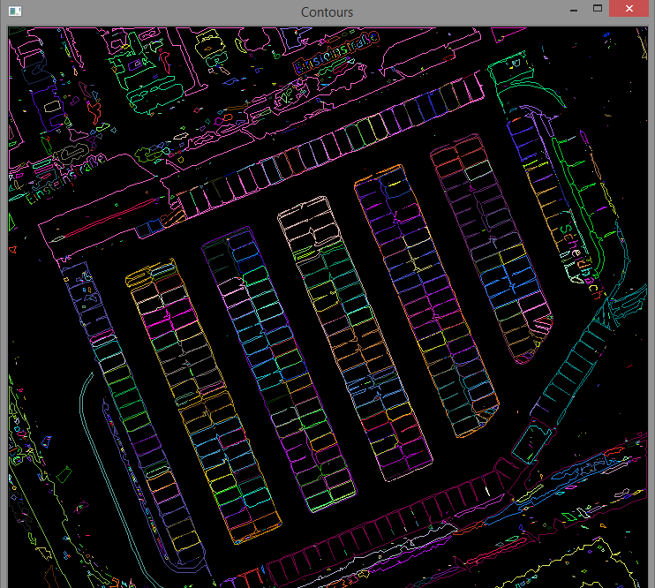
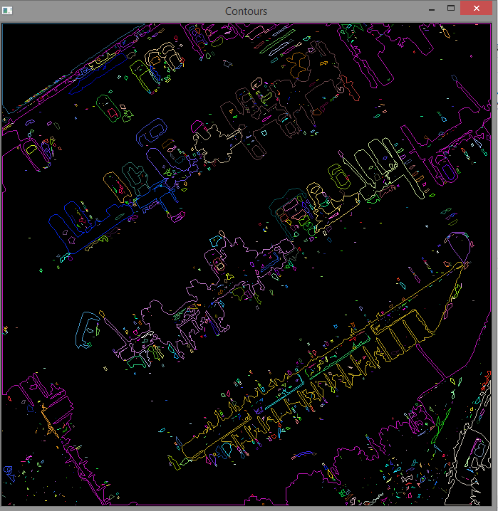
Contour detection: Works well for bounded rectangle Images, but not for others.

Slide 5
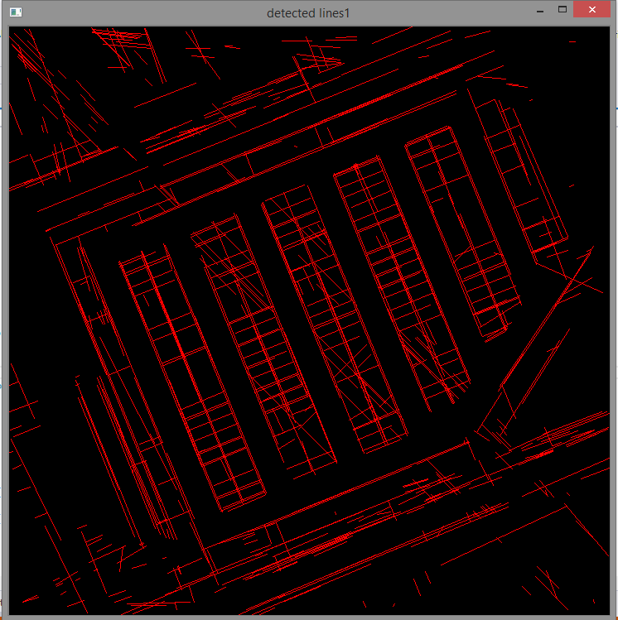
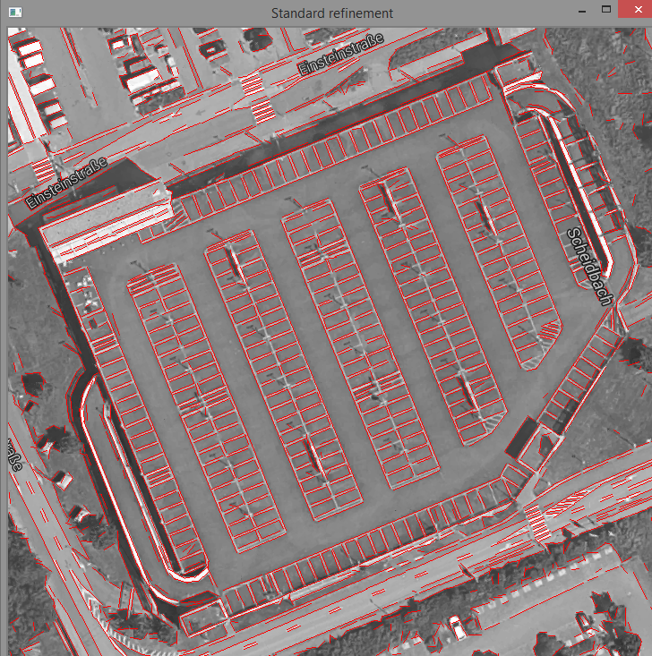
Line detection (Vectors with end points)
Probabilistic Hough Line Transformation on Canny Edge detector
LSD Line Segment Detection: Detects line segments.

Slide 6
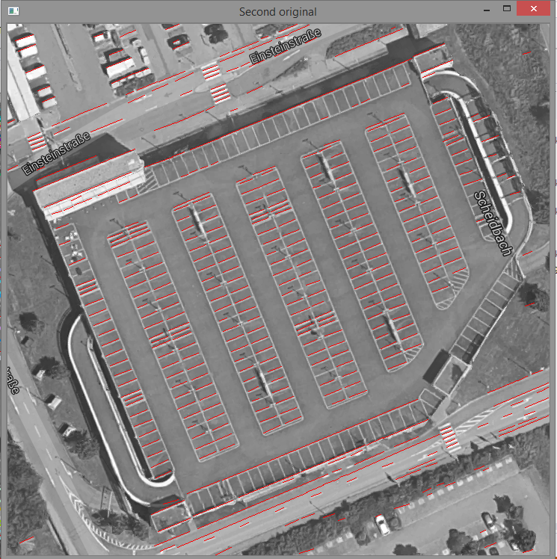
Strategies applied to reduce further noise
Storing most occurring line lengths and angles.
For every most occurring angle, checking Aspect Ratio between lines and also the length of the lines.
Eliminating lines which do not lie in range of most occurring length.
While checking Aspect ratio, considering only the lines with maximum length and mid points of both the lines and drawing the rectangle.

Slide 7
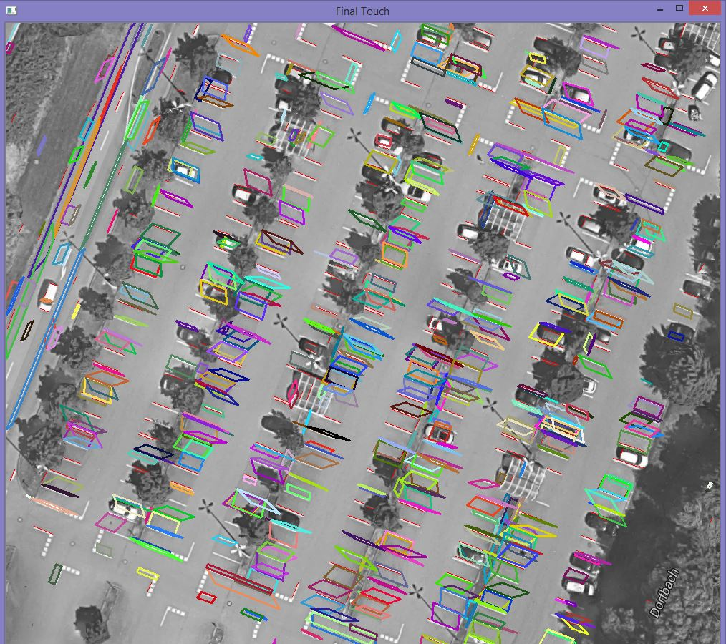
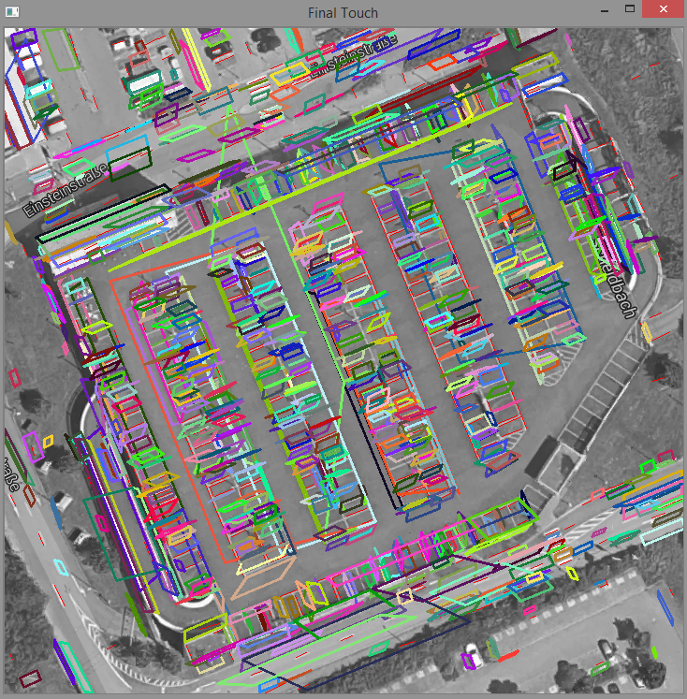
Final detected rectangles on Parking Space
Most shapes drawn at parking space.
The parking space detected are not rectangle in shape, due to dissimilar sizes of line segment.
Noise reduction in terms of Overlapping, Large, unwanted trapezoid can be done.

